Slide 1



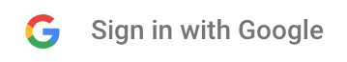



Home
Expenses
Visual Log
Ask Piggy
Login
Email
Password
Sign in
Don’t have an account? Sign up
Forgot your password?

Slide 2
Sign up now
Home
Expenses
Visual Log
Ask Piggy
Login
Email
Password
Repeat Email
Repeat password
First Name
Last Name
Make account

Slide 3
Home
Expenses
Visual Log
Ask Piggy
Login
Forgot your password?
Email
Find my account

Slide 4


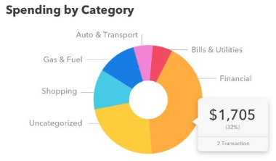
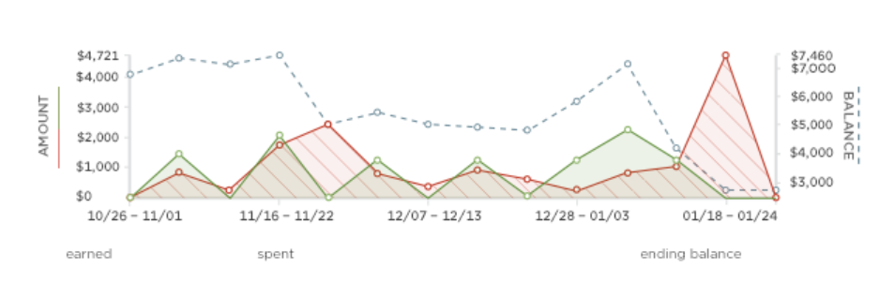
Search your expenses
Overview
Home
Expenses
Visual Log
Ask Piggy
Logout
Wallet

Slide 5



Search your expenses
Overview
Home
Expenses
Visual Log
Ask Piggy
Logout
Wallet
Bank Account
Credit Card
Wallet
$500
-$100
$3.50

Slide 6
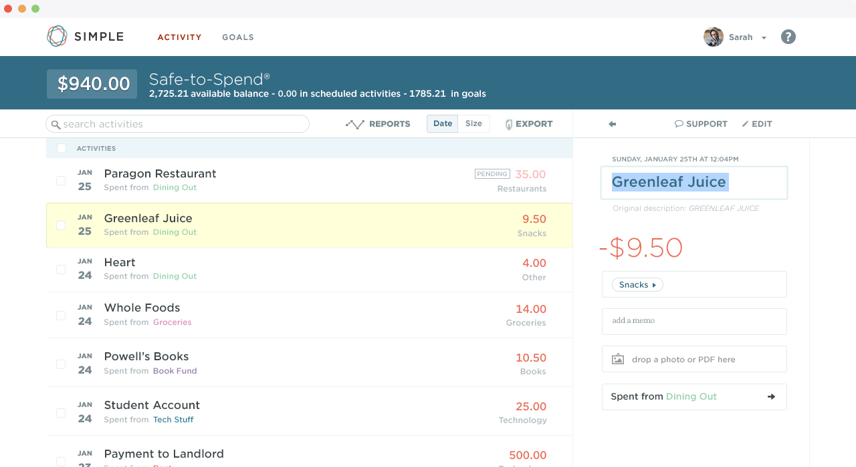


Search your expenses
Today’s Expenses
Home
Expenses
Visual Log
Ask Piggy
Logout
This Week’s Expenses
This Month’s Expenses

Slide 7
Search your expenses
Today’s Expenses
Home
Expenses
Visual Log
Ask Piggy
Logout
This Week’s Expenses
Name
Amount
Category
Tags
This Month’s Expenses
Date of Expense
Go

Slide 8
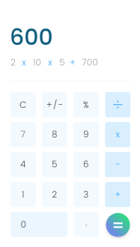
Search your expenses
Today’s Expenses
Home
Expenses
Visual Log
Ask Piggy
Logout
This Week’s Expenses
This Month’s Expenses

Slide 9
Search your expenses
Today’s Expenses
Home
Expenses
Visual Log
Ask Piggy
Logout
This Week’s Expenses
This Month’s Expenses

Slide 10
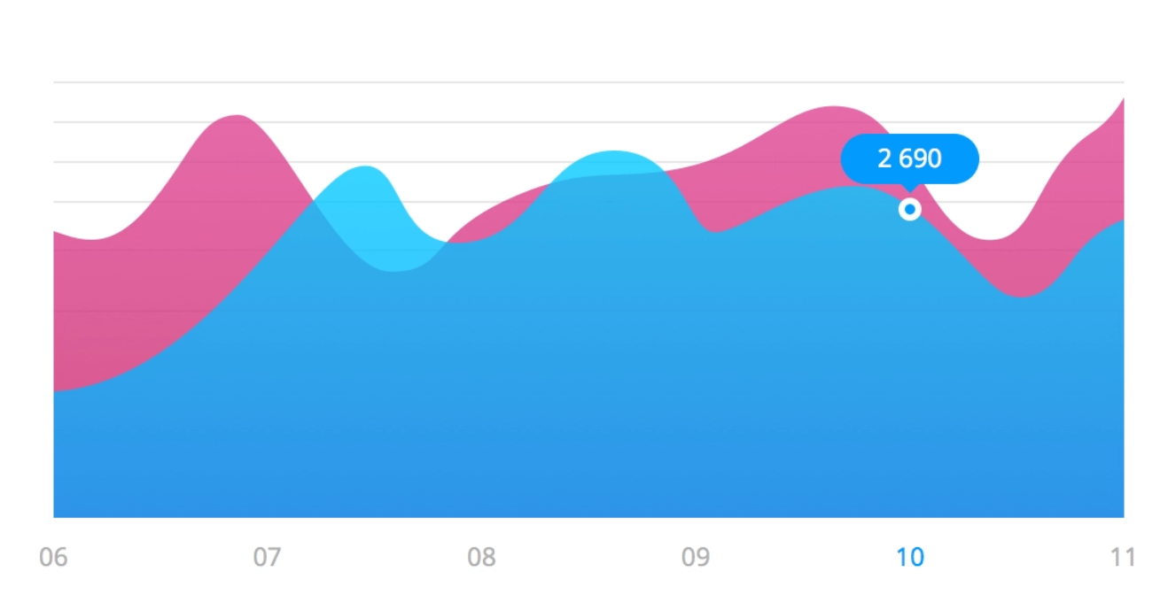
Search your expenses
Home
Expenses
Visual Log
Ask Piggy
Logout
This month versus last month
You’re doing great so far!
Change the range

Slide 11
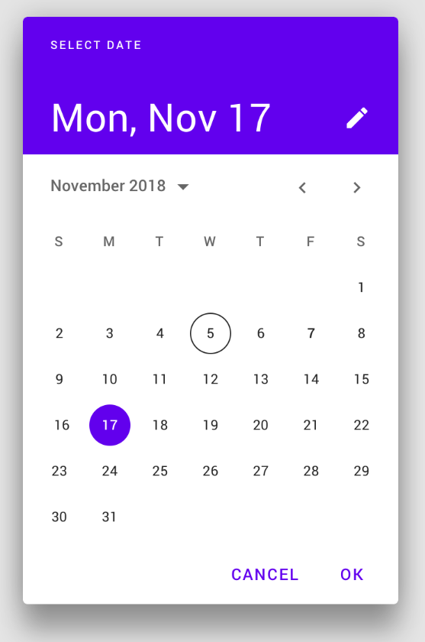
Search your expenses
Change the range
Home
Expenses
Visual Log
Ask Piggy
Logout

Slide 12
Search your expenses
Home
Expenses
Visual Log
Ask Piggy
Logout
XX/XX/XX versus XX/XX/XX
Hmm… not so good
Change the range

Slide 13

Search your expenses
Home
Expenses
Visual Log
Ask Piggy
Logout
Ask Piggy
What are you looking to answer?
For example: “How much money should I save?”

Slide 14
Search your expenses
Home
Expenses
Visual Log
Ask Piggy
Logout
How much do you want to spend per month?
l
Go

Slide 15
Search your expenses
Home
Expenses
Visual Log
Ask Piggy
Logout
If you spent $30 a month while saving $20 each month, you can save $60 in three months
Try again

